Slide 1
FUNDAMENTALS OF SOFTWARE PROJECT MANAGEMENT
Project Monitoring and Control
Week -14

Slide 2
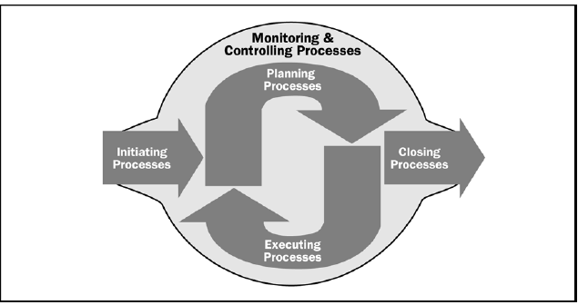
Project Management Process Groups

Slide 3
Project Monitoring and Control
Monitoring – collecting, recording, and reporting information concerning project performance that project manger and others wish to know
Controlling – uses data from monitor activity to bring actual performance to planned performance
Outputs include performance reports, requested changes, and updates to various plans

Slide 4
Why do we monitor?
Simply because we know that things don’t always go according to plan (no matter how much we prepare)
To detect and react appropriately to deviations and changes to plans

Slide 5
Project Control
Ongoing effort to keep your project on track
4 primary activities:
  1. Planning performance
    schedule, and a control process
  2. Measuring status of work performed
    Actuals
  3. Comparing to baseline
    Variances
  4. Taking corrective action as needed
    Response
Prerequisite to good control is a good plan
Notes:
Planning: This is like mapping out your journey and setting a course. You create a schedule and establish processes to control the project.
Measuring: As you sail, you keep track of where you are and how far you've come. In project terms, this means recording the actual work done.
Comparing: You compare your current position to where you planned to be. This helps you spot any deviations or differences (variances) from your original plan.
Corrective Action: If you're off course, you make adjustments to get back on track. Similarly, in projects, you take corrective action to address any discrepancies and keep things moving forward smoothly.

Slide 6
Project Control
“Control”
    Power, authority, domination. No.
    Guiding a course of action to meet an objective. Yes.
Principles
    Work is controlled, not workers
      Control helps workers be more effective & efficient
    Control based on work completed
    Balance
      Appropriate level between too much and too little
      Includes:
        Micro-managing vs. neglect
        Too much tracking detail vs. too little
Notes:
Balance: Control should strike a balance between being too hands-on (micromanaging) and being too hands-off (neglecting). It's about finding the right level of detail and oversight to keep things on track without stifling progress.

Slide 7
Progress Monitoring
The 3 key Progress Monitoring Questions
  What is the actual status?
  If there’s a variance, what is cause?
  What to do about it?
Possible responses
    1. Ignore
    2. Take corrective action
    3. Review the plan

Slide 8
Progress Monitoring
Monitoring rates
  Daily, weekly, monthly
  If problems occur – then adjust
    You may have to monitor problem areas more closely
    For some period of time
    Almost always there’s one or more areas under closer scrutiny
Status Reporting
  Part of the communications management plan

Slide 9
Status Reports
From team to PM, from PM to stakeholders
Typical format for letter
  Summary
  Accomplishments for this period (done)
    Tasks, milestones,
    Plans for next period (to-do)
  Risk analysis and review
  Issues & Actions
Shoot for weekly updates
  Email notes, then hold brief meeting
  More frequently during crises

Slide 10
Traffic Light Assessment (RAG Reporting)
Traffic Light Assessment (RAG Reporting) is a method in project management to visually indicate the status of project elements:
Red: Not on track, needs immediate attention.
Amber: Not on track but recoverable with effort.
Green: On track, meeting targets.
Used in reports and meetings for quick understanding and decision-making.

Slide 11
Traffic Light Assessment (RAG Reporting)
Identify the key element
Break these key element in constitute element
Access each second level element
  Green (on target)
  Amber (not on target but recoverable)
  Red (not on target but recoverable with difficulties)
Review all the second level assessment to arrive at first level assessment

Slide 12
Project Control Cycle
PLAN
Specifications
Project Schedule
Project budget
Resource plan
Vendor contracts
ACTION
Correct deviations from plan
RE-PLAN as necessary
MONITOR
Record status
Report progress
Report cost
COMPARE
Actual status against plan
Schedule
Cost

Slide 13
Project Control Cycle
PLAN
ACTION
MONITOR
COMPARE

Slide 14
Project Control
Control – process and activities needed to correct deviations from plan
Control the triple constraints
  time (schedule)
  cost (budget, expenses, etc)
  performance (specifications, testing results, etc.)

Slide 15
Techniques for monitoring and control
Earned Value Analysis
Critical Ratio

Slide 16
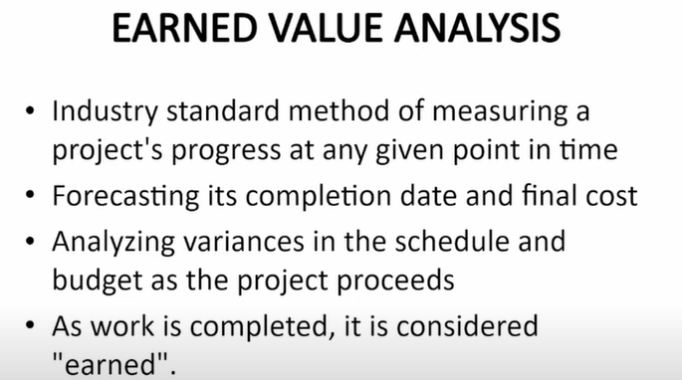

Slide 17
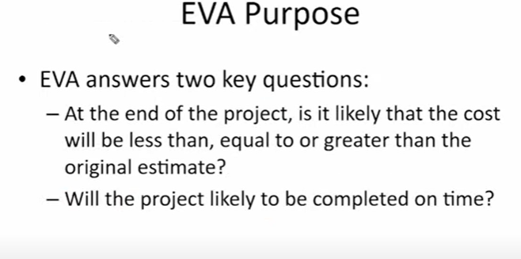

Slide 18
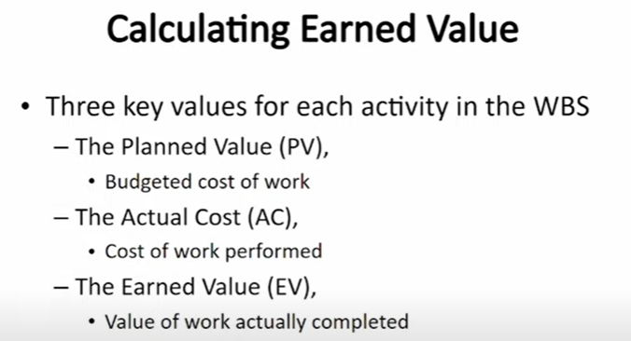

Slide 19
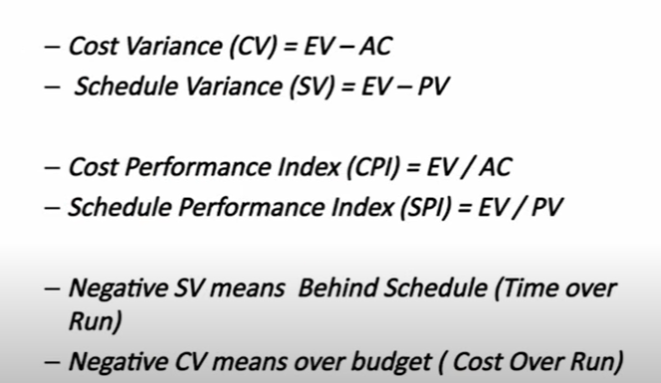

Slide 20
Earned Value Analysis (EVA)
Earned Value analysis is a method of performance measurement
EVA is also called Variance Analysis
Metric of project tracking
“What you got for what you paid”
  Physical progress
Pre-EVA ‘traditional’ approach
  1. Planned time and costs
  2. Actual time and costs
  Progress: compare planned vs. actual
EVA adds third dimension: value
  Planned, actual, earned

Slide 21
Earned Value Analysis
If total value of the work accomplished is in balance with the planned (baseline) cost, and actual cost then top mgmt has no particular need for a detailed analysis of individual tasks
Old models include cost & expenditure
EVA adds schedule estimation
Measured in dollars or hours

Slide 22
Earned Value Analysis
PV - Planned Value, estimated value of the planned work Budgeted Cost
EV – Earned Value, estimated value of work done Actual work completed
AC – Actual Cost, what you paid
BAC – Budget at Completion, the budget for the total job

Slide 23
Derived EVA Variances
    Planned Value (PV). Authorized budget assigned to scheduled work for an activity or WBS component. Total PV for the project is also known at Budget At Completion (BAC).
    Earned Value (EV). A measure of work performed expressed in terms on the budget authorized for that work. It’s often used to calculate the percent complete of a project.
    Actual Cost (AC). It is the total cost incurred in accomplishing the work that the EV measured.

Slide 24
EVA Variances
  Variances from the approved baseline will also be monitored:
    Schedule Variance (SV).
    SV = EV – PV
    Cost Variance (CV).
    CV = EV – AC
Notes:
The SV is calculated in terms of the difference in dollar value between the amount of work that should have been completed in a given time period and the work actually completed.
Cost Variance (CV) – The difference between the planned cost of work performed (BCWP) and actual cost incurred for the work (ACWP). This is the actual dollar value by which a project is either overrunning or underrunning its estimated cost.

Slide 25
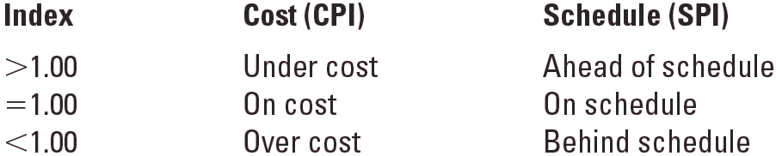
Derived EVA Ratios
  SPI: Schedule Performance Index
      EV/PV
  CPI: Cost Performance Index
      EV/AC
  Interpretation of Indexes

Slide 26
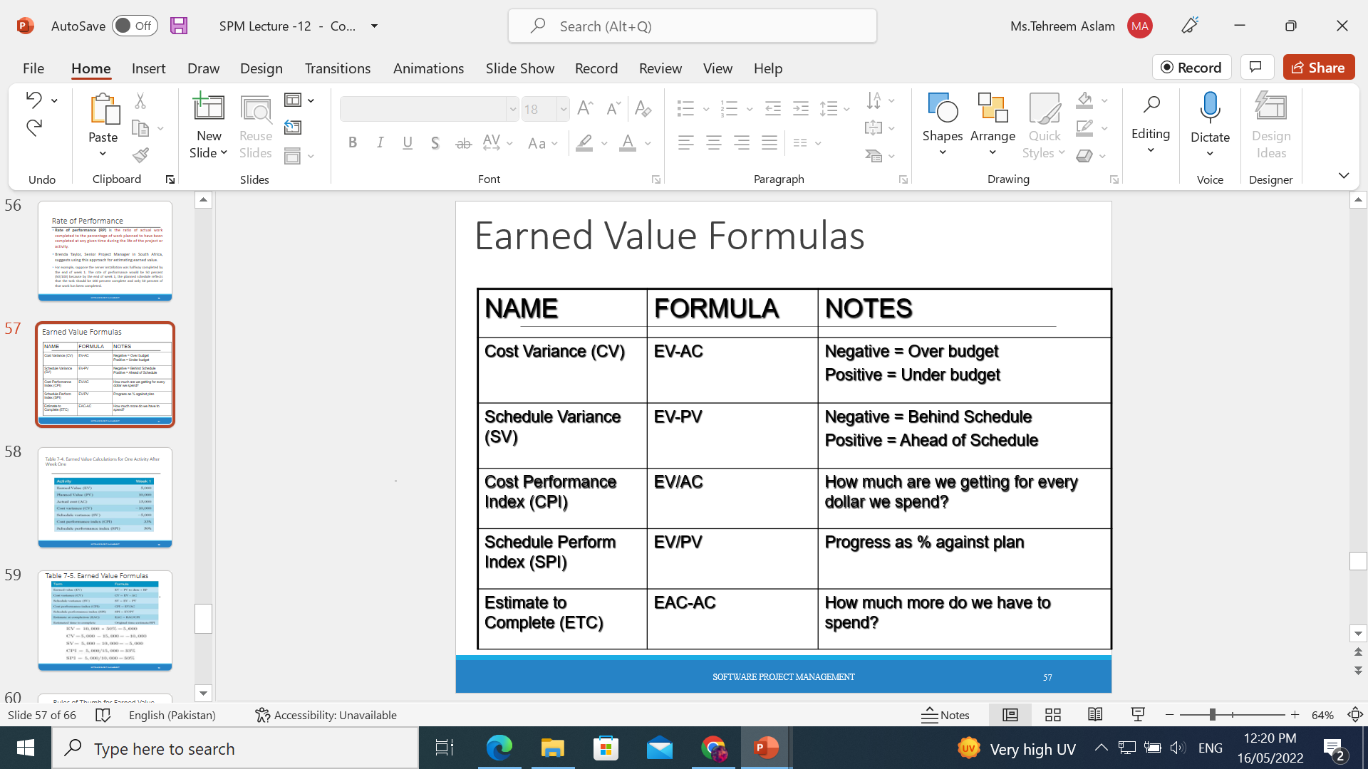
Earned Value Formulas

Slide 27
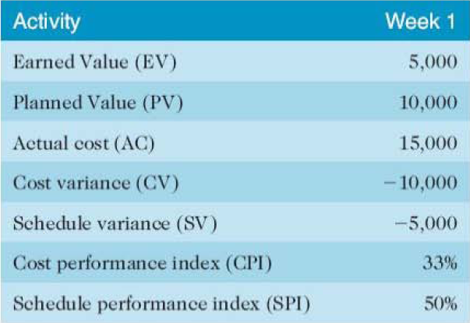
Activity

Slide 28
Activity

Slide 29
EVA Example-1
You have a project to be completed in 12 months and total cost of project is $100,000. Six months have been passed (and schedule says that 50% of work should be completed).
Six months have been passed and $60,000 is spent but on closer look you find that only 40% of work is completed so far.

Slide 30
EVA Example-1
Planned Value (
  Project duration – 12 months
  Project Cost (BAC) = $100,000
  Percent complete – 50% (as per the schedule)
  Planned Value = 50% of value of total work
  = 50% of BAC
  = 50% of $100,000
  = (50/100)X $100,000
  = $50,000

Slide 31
EVA Example-1
Earned Value (EV)
Hence, Earned Value is = 40% of value of total work
= 40 % of BAC
= 40% of $100,000
= 0.4X$100,000
= $40,000
Therefore, Earned Value (EV) is $40,000
Actual Cost (AC)
And in our question, you have spent $60,000 on the project so far.
Hence, Actual Cost is $60,000
      Calculate CV, SV, SPI and CPI?

Slide 32
Earned Value Analysis
Benefits
  Consistent unit of measure for total progress
  Consistent methodology
    Across cost and completed activity
    Apples and apples comparisons
  Ability to forecast cost & schedule
  Can provide warnings early
Success factors
  A full WBS is required (all scope)

Slide 33
Critical Ratio
CR: Critical Ratio
CR = SPI x CPI
1: everything on track
> .9 and < 1.2 ok

Slide 34
Prioritizing monitoring
We might focus more on monitoring certain types of activity e.g.
Critical path activities
Activities with no free float – if delayed later dependent activities are delayed
Activities with less than a specified float
High risk activities
Activities using critical resources
Notes:
Critical path activities – by definition if these are late then the project as a whole will be delayed
Activities with no free float – free float was defined in Lecture/Chapter 6. A project with no free float will delay following dependent activities, although the project end date may not be directly threatened.
Activities with less than a specified float – projects when being executed can be very dynamic: some activities will take longer than estimated others less; this could lead to the critical shifting. Activities with small floats are the most likely to find themselves turned into activities on the critical path if their floats get eroded.
High risk activities – recall the calculation of activity standard deviations in Chapter 7. If the standard deviation for an activity is large, this indicates that there is a lot of uncertainty about how long it will actually take.
Activities using critical resources – some resources may only be available for a limited period and if the activities that need the resource are delayed the resource could become unavailable.

Slide 35
Getting back on track: options
Renegotiate the deadline – if not possible then
Try to shorten critical path e.g.
  Work overtime
  Re-allocate staff from less pressing work
  Buy in more staff
Reconsider activity dependencies
  Over-lap the activities so that the start of one activity does not have to wait for completion of another
  Split activities
Notes:
Renegotiating the deadline – one way of doing this is to divide the deliverables into ‘tranches’ (see Lecture/Chapter 3), delivering the ones most valuable to the client on or before the deadline, but delaying less valuable ones.
Shortening the critical path – the idea is to try to get things done more quickly by adding more staff. Some activities lend themselves to this more readily than others – it is often quite difficult to do this with software development. It also increases costs
Reconsidering activity dependencies – allowing activities to overlap often increases the risk of quality shortfalls

Slide 36
Typical change control process
One or more users might perceive the need for a change
User management decide that the change is valid and worthwhile and pass it to development management
A developer is assigned to assess the practicality and cost of making the change
Development management report back to user management on the cost of the change; user management decide whether to go ahead

Slide 37
Change control process contd.
One or more developers are authorized to make copies of components to be modified
Copies modified. After initial testing, a test version might be released to users for acceptance testing
When users are satisfied then operational release authorized – master configuration items updated

